Slide 1
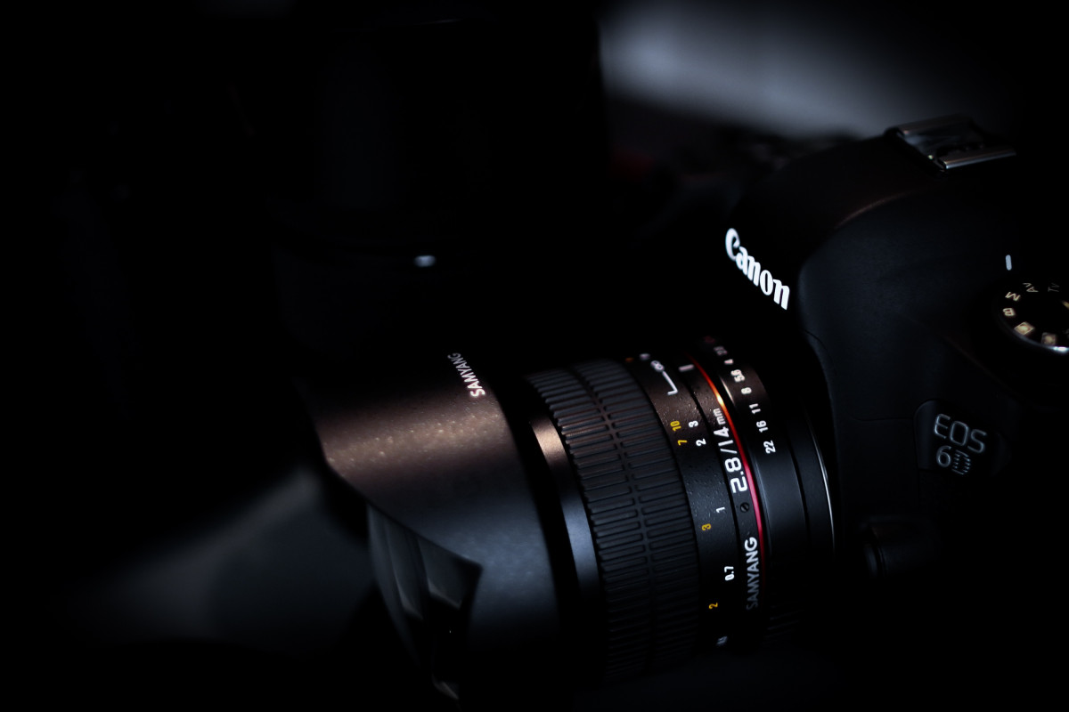

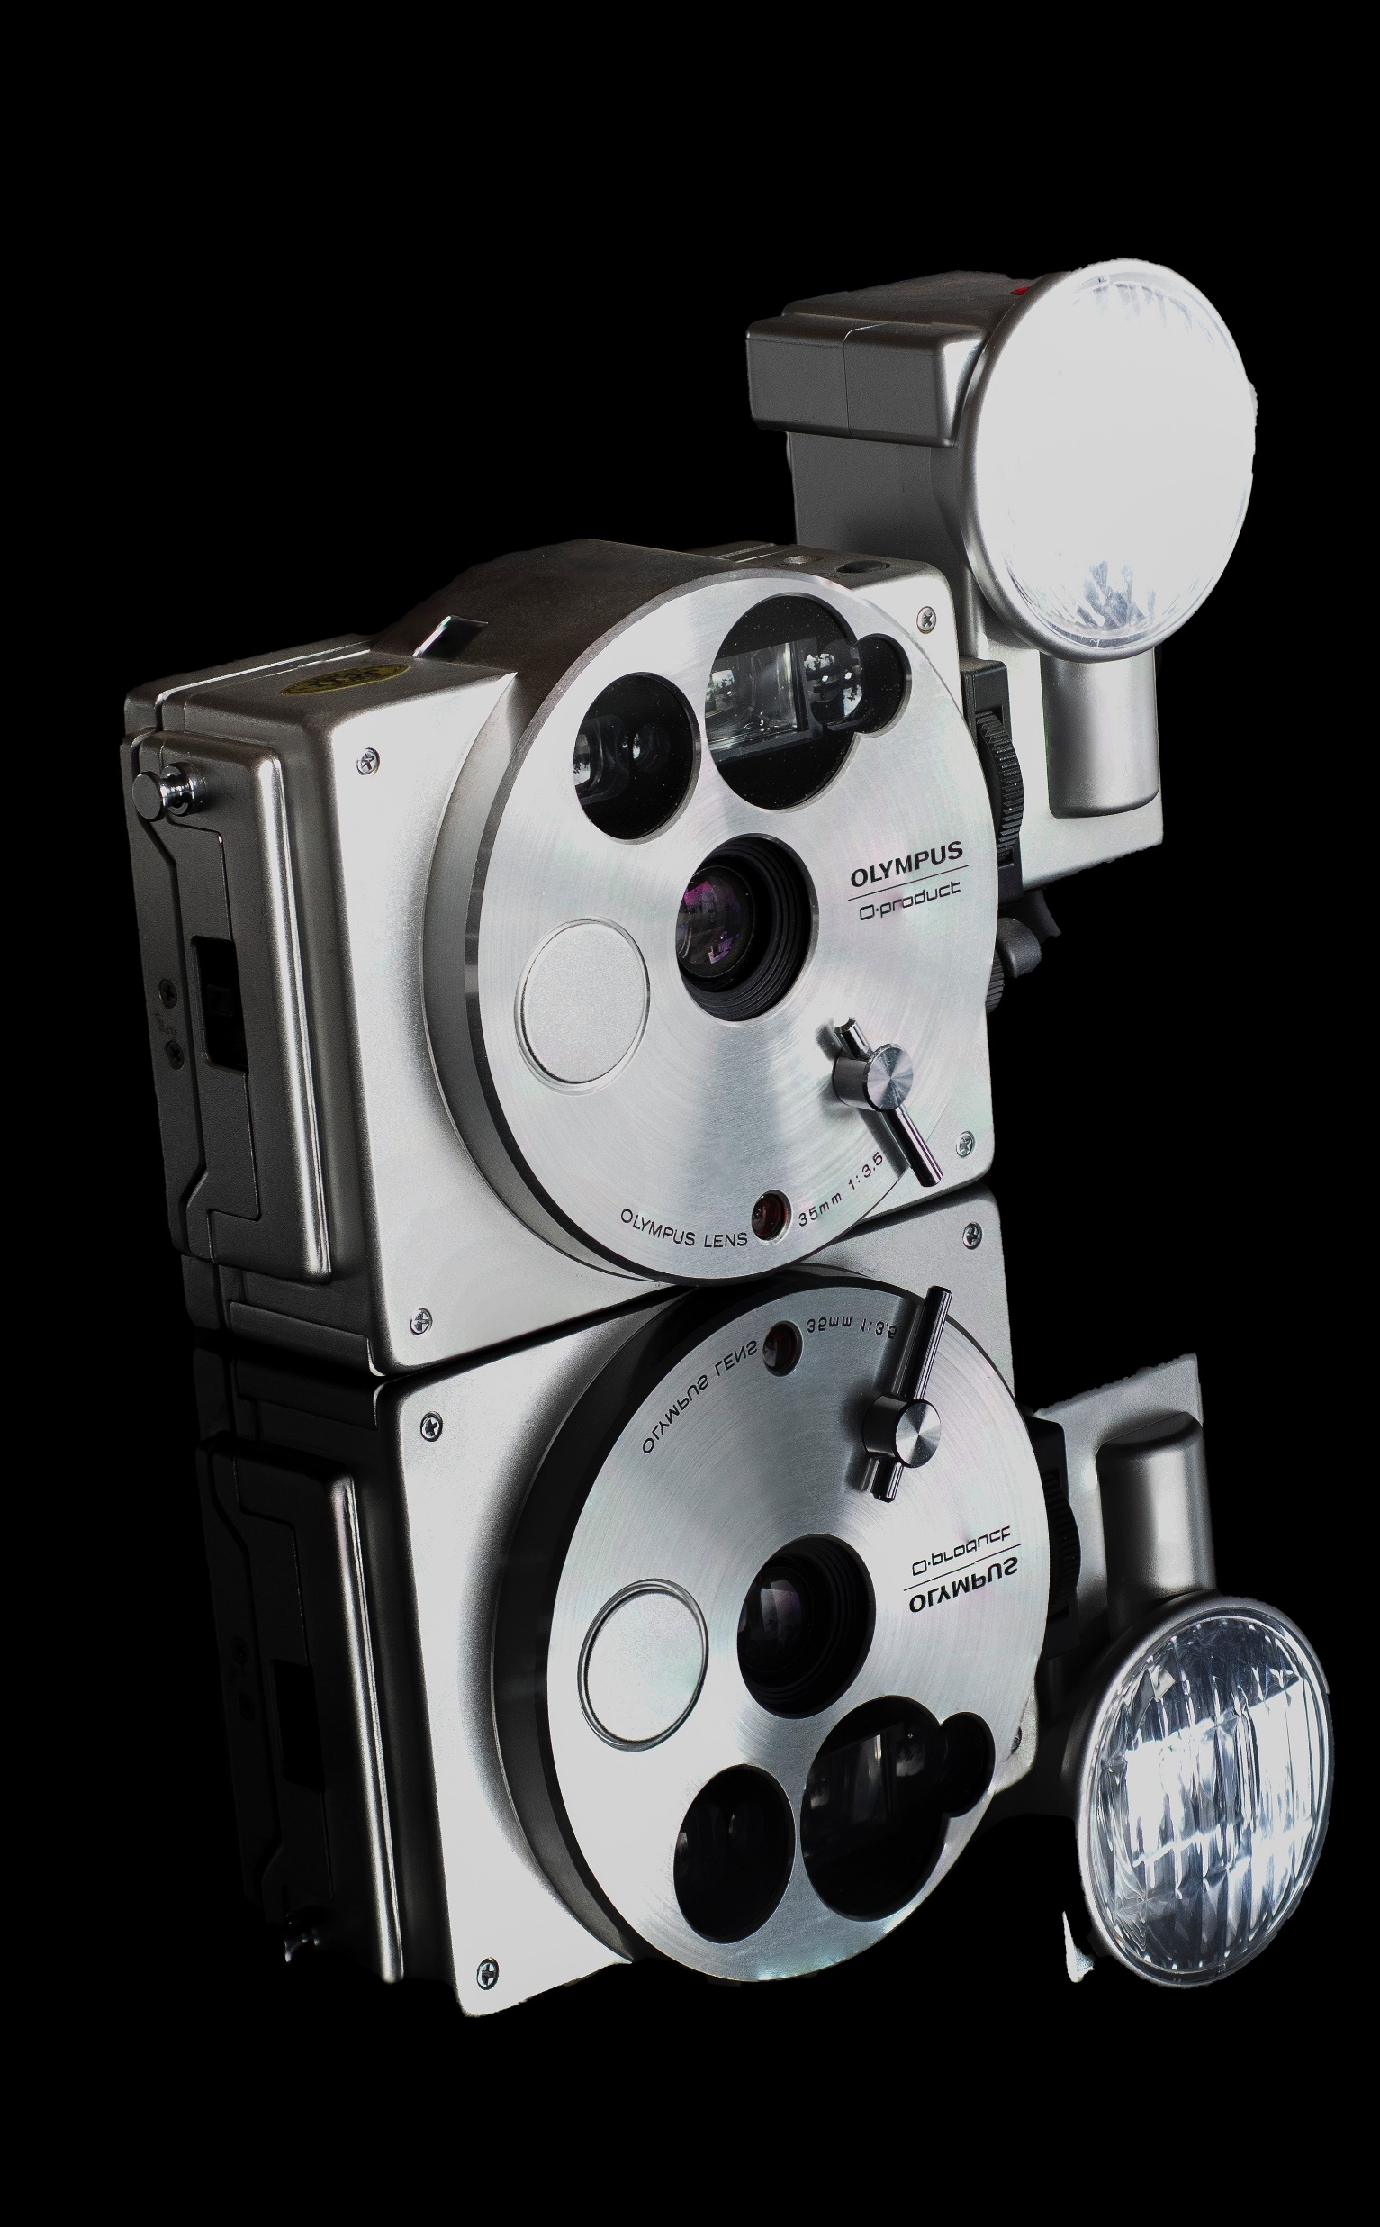
APP PHYSICS 167
APPLIED OPTICS
MODULATION TRANSFER FUNCTION
IMAGING OPTICS AND ELECTRONICS
NINO PHILIP RAMONES | GITHUB
2020 – 05616
OCTOBER 23, 2023

Slide 2

APP PHYSICS 167
MODULATION TRANSFER FUNCTION
OBJECTIVES
Measure the resolution of an imaging device through its modulation transfer function (MTF)
Determine the MTF through a line crossing edge profile and observe the response as a function of spatial frequency
KEY TAKEAWAYS
The MTF is the Fourier transform of the point spread function of the system, which is the derivative of an edge profile
The edge profile is simply the pixel values across the line crossing edge, which is used in the slanted edge technique in determining the MTF
Resolution targets have accurate prints of line pairs at varying spatial frequency which can be resolved by a camera to a fine detail limit
SOME PITFALLS
MTF requires proper scaling on the pixel values from an image space to spatial frequency after applying the Fourier transform operation
Capturing burst images of the resolution test chart must have minimal noise and movements to have a much more accurate camera resolution value

Slide 3
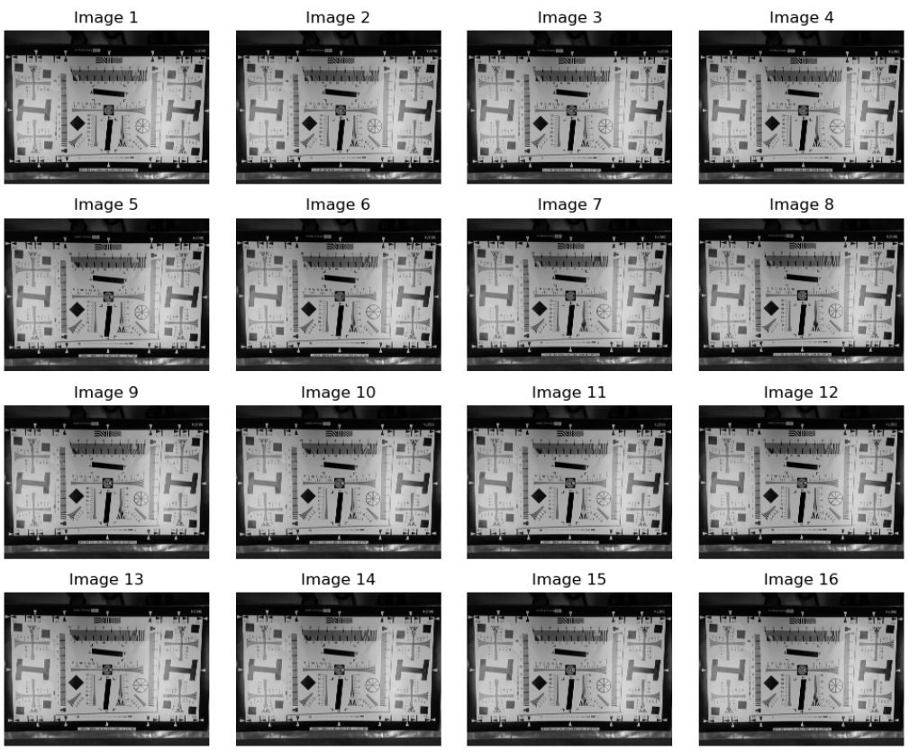
APP PHYSICS 167
MODULATION TRANSFER FUNCTION
EXPERIMENTAL SETUP
Figure 1. Burst shots of the resolution chart.
The first part of the activity takes burst shot pictures of the resolution chart. This was done by setting up the phone camera (Samsung A52S) at a fixed distance away from it. It was also made sure that the camera and slanted edge image (printed pattern) were parallel to one another.

Slide 4
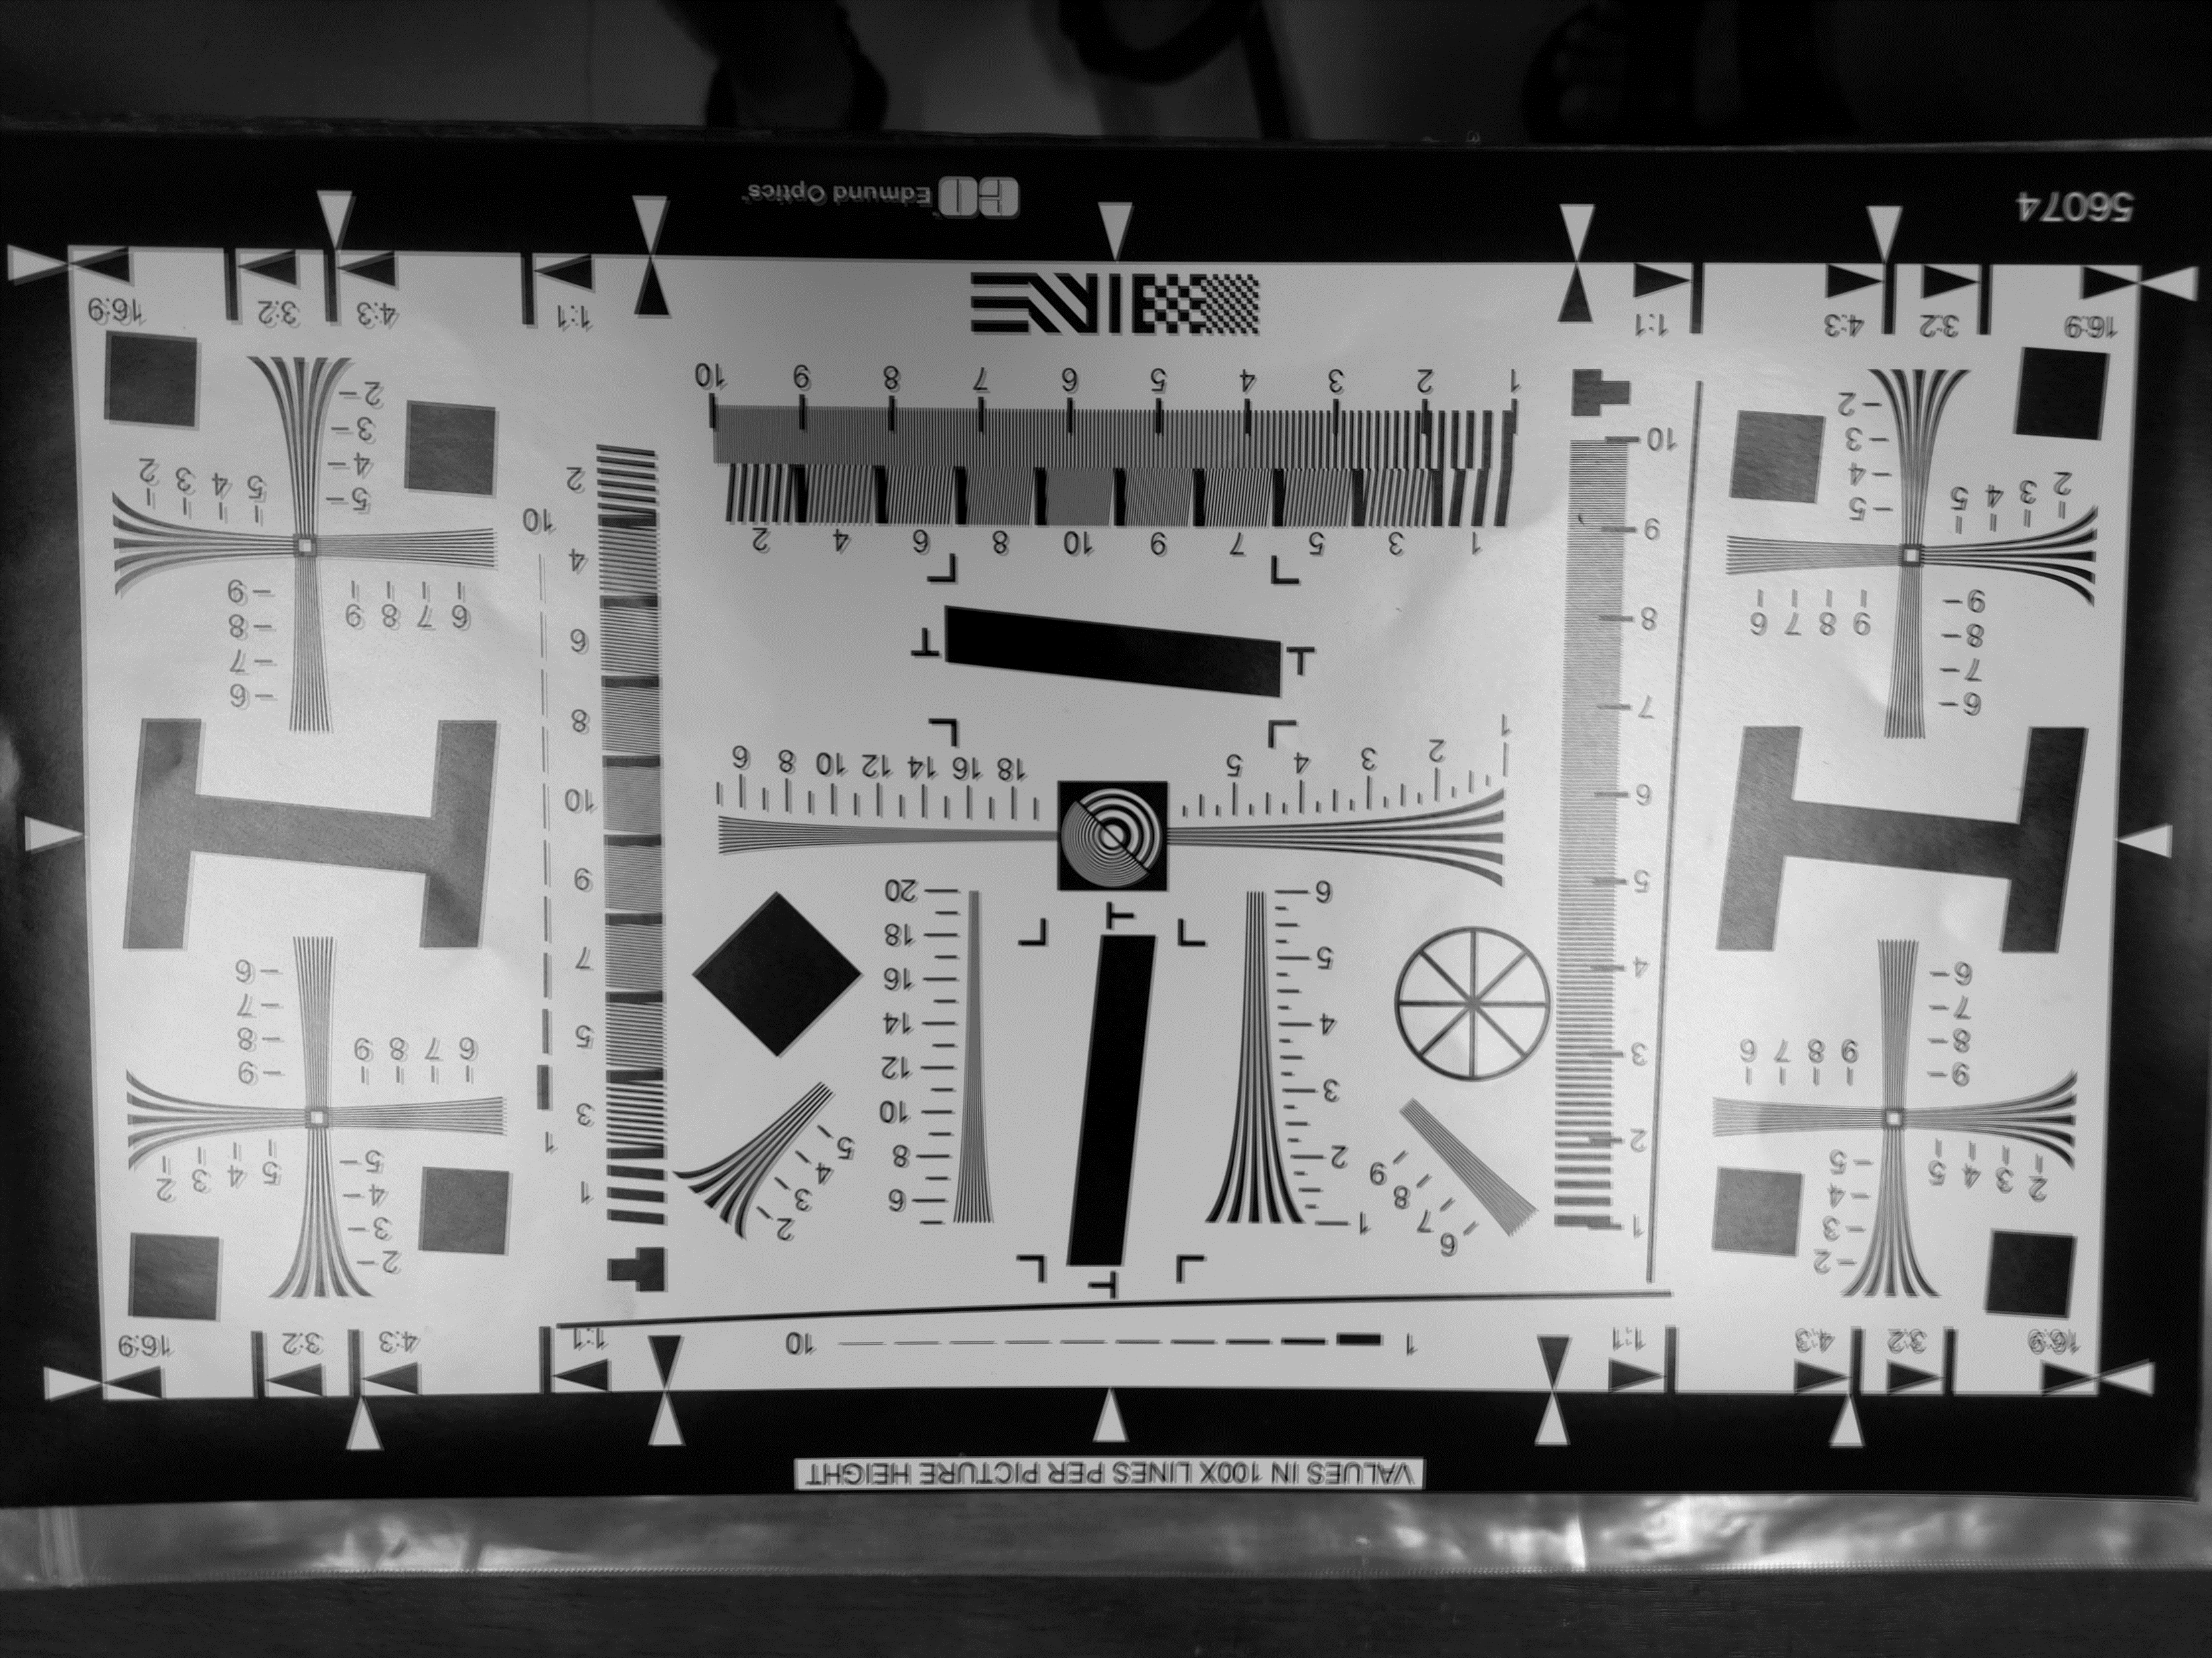
APP PHYSICS 167
MODULATION TRANSFER FUNCTION
EXPERIMENTAL SETUP
Figure 2. Average image of the burst shots taken.
Prior to averaging the burst images, each image was converted to grayscale to simplify the computation and eliminate complexities compared to when dealing with RGB channels. The average grayscale value per pixel were obtained to minimize the noise present in the image such as movements on the camera. However, averaging did not resolve the noise as some parts of the image were a bit shaky as seen.

Slide 5
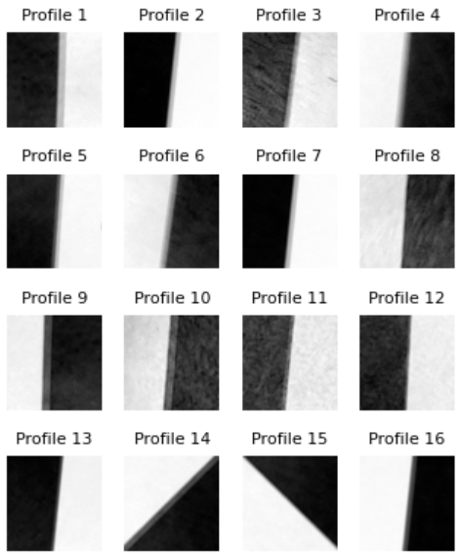
APP PHYSICS 167
MODULATION TRANSFER FUNCTION
EXPERIMENTAL SETUP
Figure 3. Sample edge profiles from the averaged grayscale resolution chart photos.
Several slanted edges were captured for the activity, all of which were obtained on the different solid, filled shapes on the resolution chart. The edges were chosen in a way such that the amount of area occupied by the black and white regions are almost equal. In the results and discussion, only one profile was used for analysis and in quantifying the camera resolution through the MTF.

Slide 6
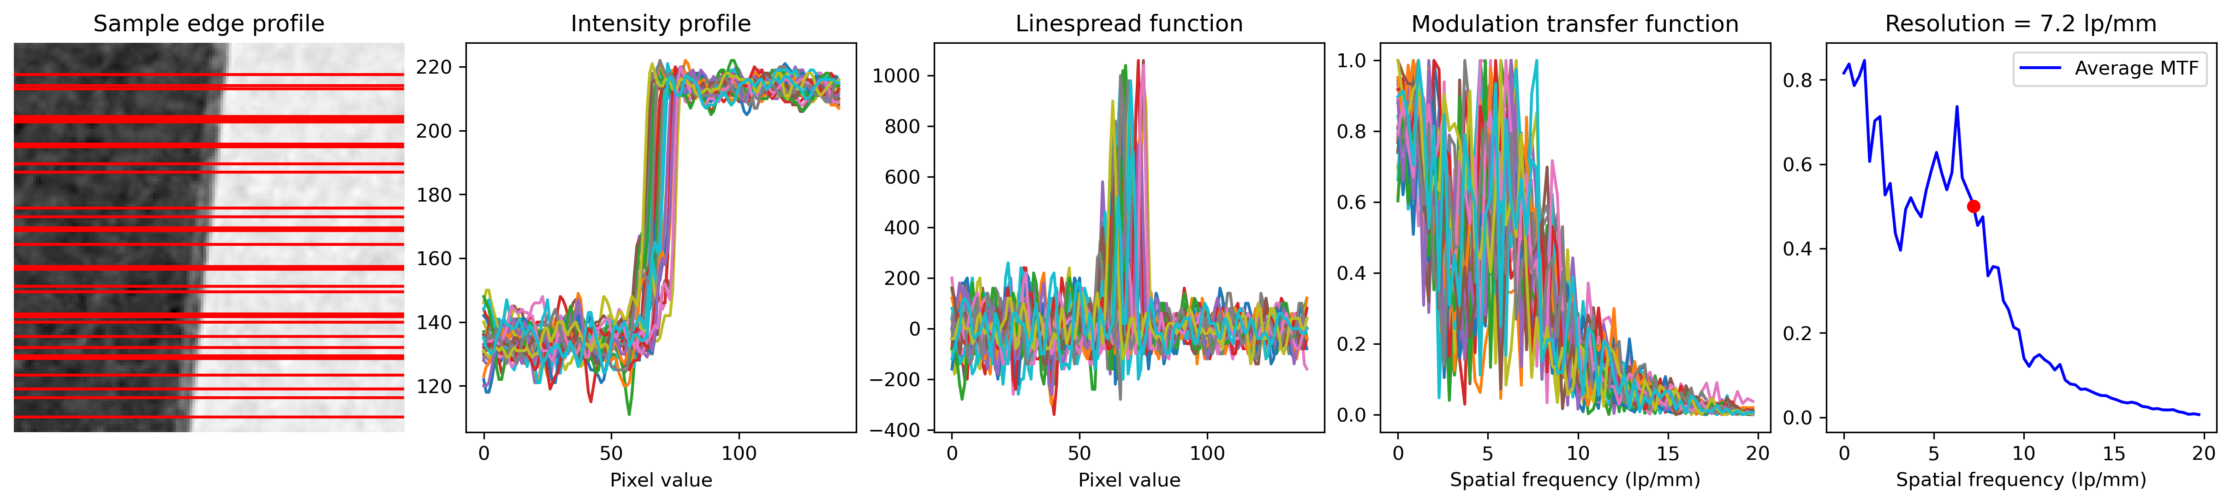
APP PHYSICS 167
MODULATION TRANSFER FUNCTION
RESULTS AND DISCUSSION
Figure 4. Sample edge profile with various line crossing edges, the corresponding modulation transfer functions per line edge, and the average MTF in determining the resolution as shown in red dot.
Across all edge profiles shown previously in last slide, interpolating the MTF and spatial frequency where MTF is at 0.5 resulted in a maximum resolution of 7.2 lp/mm for the camera used. 30 random line crossings were made on the edge profiles as indicated in red lines on Figure 4. The corresponding intensity profile or gray values for every line were then observed. As expected, the differences in gray values between the dark and white region were apparent as the gray value at the middle of the image where the edge is located spiked to large values.
The linespread function was calculated by taking the derivative of the the intensity profile. Taking the modulus or power spectrum of the linespread function and averaging for all samples yields the MTF of the imaging system.

Slide 7
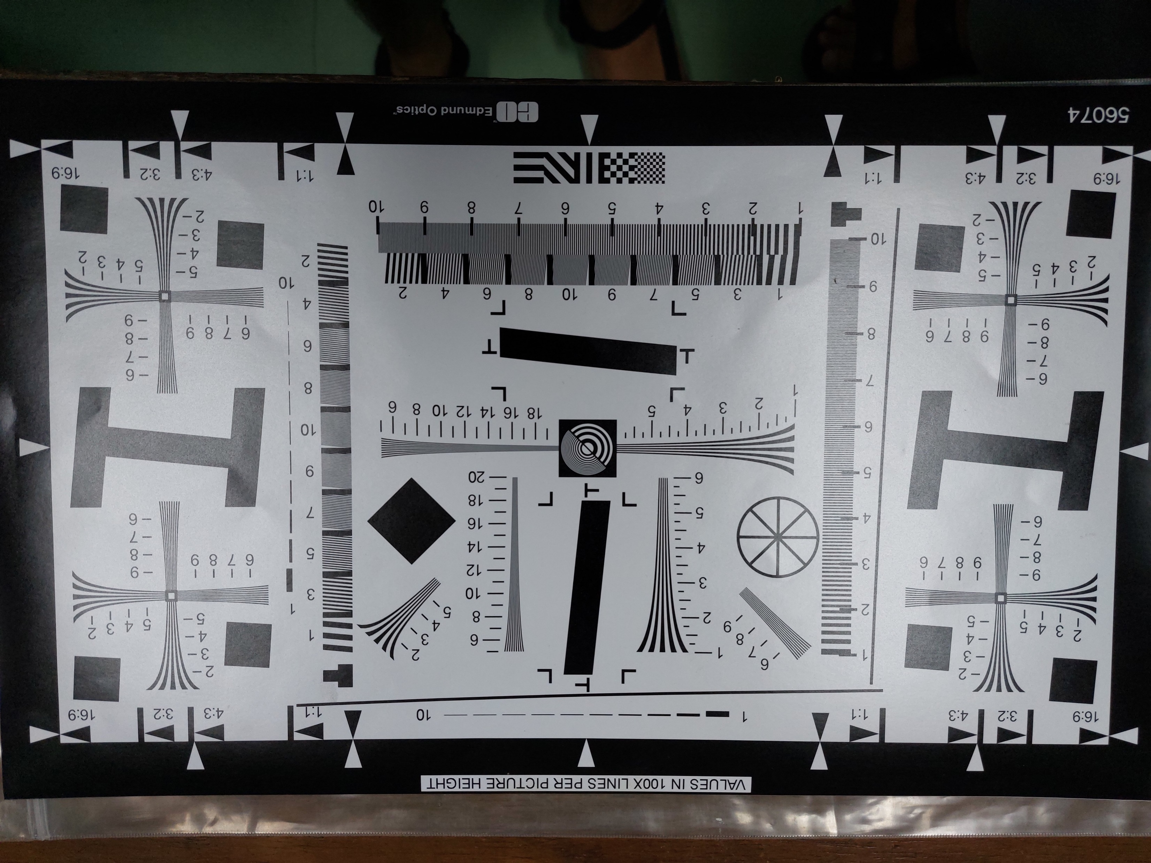
APP PHYSICS 167
MODULATION TRANSFER FUNCTION
RESULTS AND DISCUSSION
In scaling the x-axis corresponding previously from the pixel value to spatial frequency after applying the Fourier transform operation on the linespread function, proper scaling was used based on the line profiles available on the resolution chart.
For example, the yellow line on the image corresponds to the point where there are 2 line pairs per millimeter. The scaling was derived by measuring the length of this yellow line in pixels. This was achieved by using ImageJ, an imaging software that can translate real life measurements to pixel lengths. The pattern size was measured to be around 250 mm by 355 mm, by which the software translates it to some length values in pixels.
Proper ratio was then implemented since it now translates to how many mm are there in one pixel is 2 mm as there is to around 8 pixels. This implies that a single pixel corresponds to a quarter of a millimeter in our scale!
Figure 5. Several line profiles on the averaged resolution chart image used in scaling the Fourier transformed plot of the line spread function. Yellow line indicates 2 lp/mm.

Slide 8
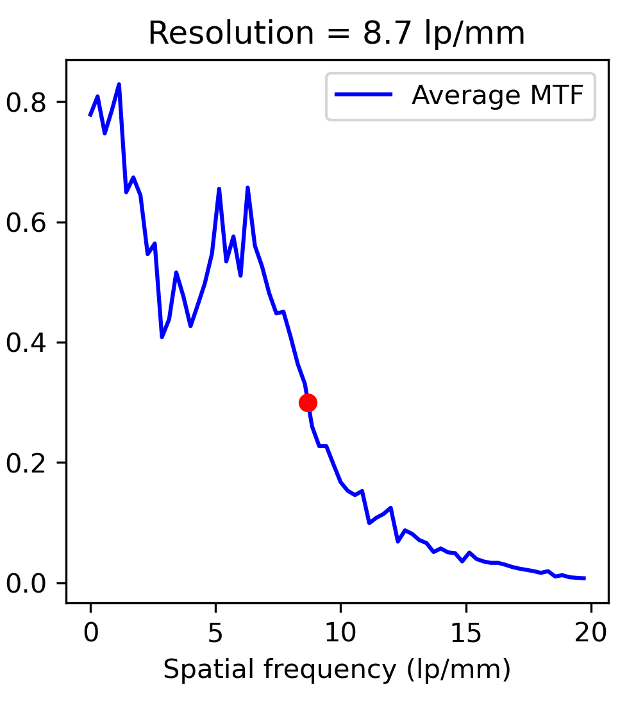
APP PHYSICS 167
MODULATION TRANSFER FUNCTION
RESULTS AND DISCUSSION
(a)
(b)
Figure 6. Camera resolution interpolated from MTF values at (a) 0.5 and (b) 0.3 as shown in red dot. For all plots, 30 line crossings were made and the average MTF was obtained as represented in solid blue line in the plot.
The camera resolution in spatial frequency can be interpolated explicitly at the lp/mm value where the MTF is at 0.5. In practice, 0.5 is used for interpolation as the perceived image sharpness is closely related to the spatial frequency where the MTF is at 50% or where the contrast has dropped to half of its low frequency value. At MTF = 0.5, the resolution was found to be around 7 lp/mm, which is slightly lower compared to the approximate 9 lp/mm for MTF at 0.3. In addition, MTF at 0.3 is tested for suitability in the assumption that the camera is sharp enough based on the Nyquist frequency of the imaging sensor. Any MTF value below this can signify an excessive, unwanted noise on the image resolution --- where the perceived image sharpness of the lines are no longer recognizable.

Slide 9
APP PHYSICS 167
MODULATION TRANSFER FUNCTION
RESULTS AND DISCUSSION
Figure 7. Line pairs in on the average resolution chart image. The range of camera resolution interpolated from the MTF algorithm for 0.3 and 0.5 were bounded by the red box for reference.
From the obtained spatial frequency resolution of the camera from the line edge profiles, we can go back to Figure 2 and examine some line pair markings that fall within that range, i.e. around 7 to 9 lp/mm. As a sanity check, it can be observed how the phone camera used managed to resolve, thought not as fine, details between 7 and 9 lp/mm. For line pairs beyond 9 lp/mm mark, the resolution is already a bit blurry as the line pairs lose details and begin to exhibit phase flipping, i.e. where the black line appear to be white and vice versa (say at >10 lp.mm). These validates the accuracy of the algorithm in determining the resolution from the MTF.

Slide 10
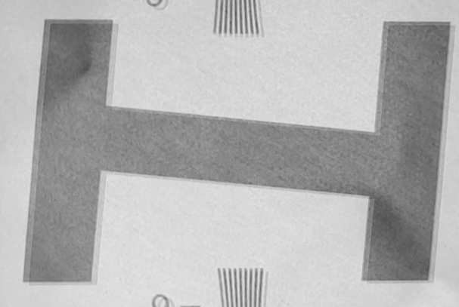
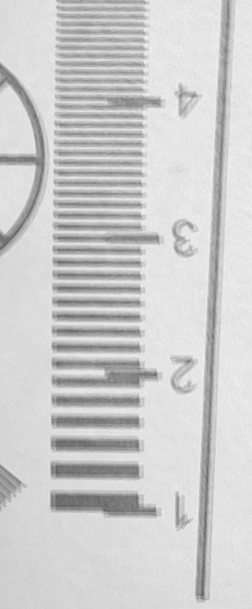
APP PHYSICS 167
MODULATION TRANSFER FUNCTION
RECOMMENDATIONS
Points for improvement and considerations
Minimize noise in the average image. The extent of detail that can be resolved by the camera can be further improved by making sure that the camera is held by a stable holder as much as possible, i.e. through the use of stabilizers or tripods. Small movements in the camera with respect to the resolution chart can already affect the MTF of the imaging system. These will also ensure that the camera sensor is parallel to the slanted edge images or patterns.
Try other cameras. Trying other camera such as that of DSLR can be used as a point of comparison on how much detail can bigger lenses and advance imaging sensors can resolve on the resolution chart by also determining their MTFs.
Figure 8. Some blurry edges on the image after averaging. Notice how the edges seemed to have been superimposed and shifted by a small amount.

Slide 11
APP PHYSICS 167
MODULATION TRANSFER FUNCTION
REFLECTION
I find the activity fun since I was able to implement the algorithm for the MTF and in determining the resolution limit of a smartphone camera. I was able to account the points for improvement in this activity. I think I could have done better in executing the activity in terms of capturing the sample images and code writeup, but it was still fulfilling to be able to understand what the activity intends to impart at all. Overall, I would give myself a score of 100/100 !
REFERENCES | GITHUB
M. Soriano, Applied Physics 167 – Modulation Transfer Function (2023)
Resolution | Edmund Optics
Understanding resolution and MTF (normankoren.com)
Compensating camera MTF measurements for chart and sensor MTF | Imatest

